Slide 1
CampusPilot AI
AI-Powered Accessible Campus Navigation
An AI-powered campus navigation assistant that helps every visitor reach the right destination — quickly, intelligently, and accessibly.
Team Composition
Name
Role
Programme
Year
Anshul Kumaria
AI & Intelligence Lead
B.Tech CSE
3rd Year
Dhruv Sarda
Core Solution Architecture Lead
B.Tech CSE
3rd Year
Hrishikesh Kali
Implementation & Feasibility Lead
B.Tech CSE
3rd Year
Atharva Deshmukh
Research & Lit. Review Lead
B.Tech CSE
3rd Year
Rishabh Alekar
Problem Analysis Lead
B.Tech CSE
3rd Year

Slide 2
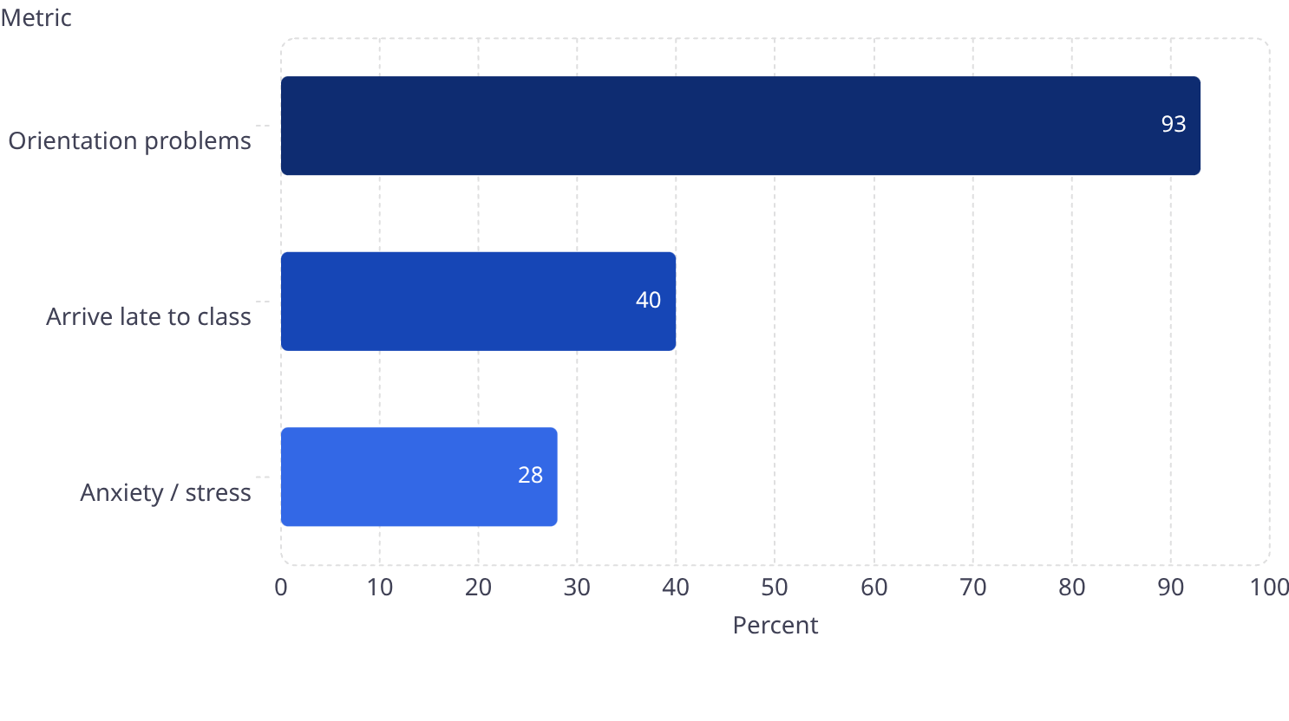
The Business Challenge
Campus navigation fails everyone — but fails disabled students completely. The gap between what navigation tools promise and what users actually experience is enormous — and measurable.
93%
40%
330+
46%
Orientation Problems
Arrive Late to Class
Registered Disabilities
App Uninstall Rate
Students report difficulty navigating campus — Evelity survey, 300 students across 107 campuses (2025)
Directly caused by navigation failure — same Evelity 2025 survey
On a 15,000-student campus — real need is 2–3× higher (MoSPI 2021)
Android apps abandoned within 30 days of install — AppsFlyer 2025 benchmark
Current Situation
Existing App Issues - By The Numbers
Current Reality
What's Needed
GPS fails indoors
Reliable indoor positioning
Accessibility is incomplete
Disability-aware routing
Maps ignore real-time constraints
Live campus context
Apps depend on internet
Offline & low-connectivity support

Slide 3
Proposed Solution
CampusPilot AI is a conversational AI agent that knows where users are indoors, routes around real constraints, serves every disability profile, and works even when the internet doesn't.
QR Indoor Positioning
Conversational Navigation
Accessibility Intelligence
Precise indoor location from QR checkpoints placed at entrances, lifts, and corridor junctions — no GPS, no beacons, no power dependency, fully offline.
Natural language queries understood by an LLM agent — intent, location, and constraints resolved in one exchange.
Five disability profiles: wheelchair, vision-impaired, hearing-impaired, cognitive, and invisible. WCAG 2.1 compliant.
Shadow Mapping
Bluetooth Mesh
Official map + real-usage map. Micro-feedback continuously corrects inaccurate campus data automatically.
Every phone is a data node. Crowd alerts and emergency signals travel device-to-device without internet.
How We Are Different
Capability
Existing Apps
CampusPilot AI
Indoor navigation
Limited or GPS-dependent
QR-based indoor positioning
Disability coverage
Usually 1–2 profiles
5 disability profiles
Real-time updates
Limited or community-based
Shadow map + live feedback
Offline support
Weak or unavailable
QR + caching + Bluetooth mesh
Conversational AI
Mostly absent
Natural language route assistant
Emergency support
Basic or missing
SOS via mesh + SMS + QR location
Benchmarked against GoodMaps, Wheelmap, BlindSquare, and AccessNow.

Slide 4




Innovation Story
Three non-obvious decisions forced by real campus constraints
We Rejected the Obvious Answer
We Solved for When Infrastructure Fails
We Designed for Who Actually Needs This
Constraint: GPS fails indoors. 46% of nav apps are uninstalled in 30 days.
Constraint: Campus WiFi saturates during events — exactly when navigation matters most.
Constraint: Existing tools treat disability as binary. Most cover only wheelchair users.
Decision: Build a conversational agent + QR positioning at ₹20/point — no hardware, no install barrier.
Decision: Five profiles built into the architecture — each with unique routing logic and interaction mode.
Decision: Bluetooth mesh + shadow mapping. The system improves as usage grows.
Outcome: Indoor location becomes solvable at campus scale, cheaply.
Outcome: No competitor covers more than two disability categories.
Outcome: Performs best when WiFi performs worst.
50%
100%
80%+
Faster Navigation
Disability Coverage
Adoption Potential
10–15 min per destination → under 2 min with the conversational agent
All five categories with distinct interaction modes — no competitor matches this
88% of students want a wayfinding app; zero-install PWA eliminates the 46% uninstall risk
"We didn't build a better map. We made three non-obvious decisions forced by real constraints — and they compounded into a campus navigation intelligence layer no existing product has reached."

Slide 5

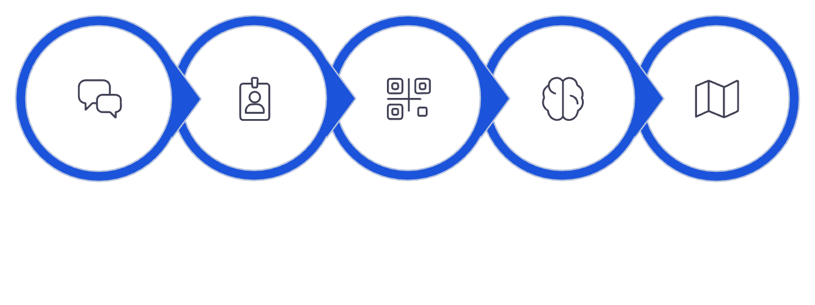






Execution Approach
A disciplined four-phase build — from raw campus data to a fully tested, accessibility-compliant navigation intelligence layer.
Agent Development
Testing & Evaluation
Data & Mapping
Navigation Intelligence
LLM agent, FastAPI backend, routing
Route accuracy, WCAG, offline reliability
Floor plans, Neo4j graph, QR rollout
Shadow map, Bluetooth mesh, offline SOS
Demo Flow
Evaluation Mapping
Criterion
CampusPilot AI Solution
Route correctness
Knowledge graph + golden dataset testing
Accessibility options
5 disability profiles + WCAG 2.1
Profile Detect
Route Reasoning
Deliver Route
Conversation UX
Natural language via Claude + LangChain
User Query
Scan QR
Context handling
Shadow map + admin-flagged updates
Tech Stack: Groq API · LangChain · FastAPI · Neo4j · React PWA · Google Nearby Connections · OpenTelemetry
Offline / low connectivity
Mesh network + progressive caching

Slide 6
Approach & Methodology
From root-cause analysis to a justified, agentic-first technical methodology — every design choice traced back to a constraint.
Problem-Solving Process
Key Assumptions
Whys: GPS fails indoors → existing tools built for outdoor use → navigation treated as a mapping problem, not an accessibility challenge.
Secondary gaps: indoor positioning, real-time context, offline resilience, multi-disability coverage.
QR codes deployable at every corridor junction, lift lobby, and entrance at ₹20/point.
Users carry smartphones; no app install required — PWA only.
Accessibility graph can be seeded manually and self-corrects via shadow mapping.
Methodology
Major Steps to Solution
Agentic AI over RAG — navigation is action-chaining, not document retrieval. The agent calls tools, holds state, and re-plans dynamically.
Neo4j over relational DB — accessible routing is a graph problem; CONNECTS_TO edges carry constraints (wheelchair_accessible, tactile_paving, stairs, lift) that Cypher filters natively.
QR over BLE beacons — no hardware cost, no battery maintenance, trivially replaceable.
Model the campus as a graph — Neo4j schema with 6 node types and CONNECTS_TO relationships.
Build 5 disability profiles as routing constraint dictionaries, not prompt descriptions.
Wire a LangChain ReAct agent to 5 tools: qr_lookup, route_query, resolve_room, profile_detect, flag_obstacle.
Pre-classify emergencies heuristically (sub-ms) before any LLM call.
Build a React PWA frontend with offline-first service worker caching.

Slide 7
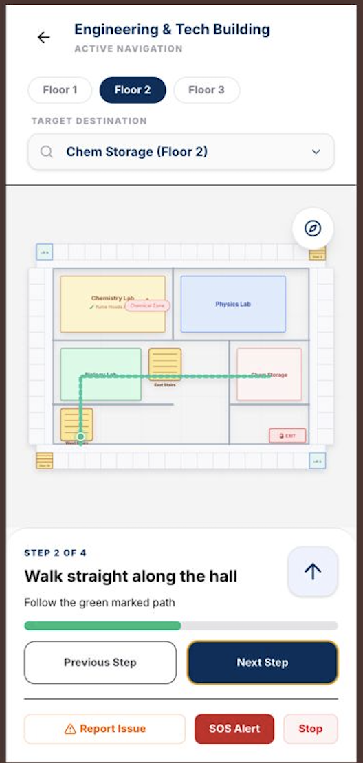
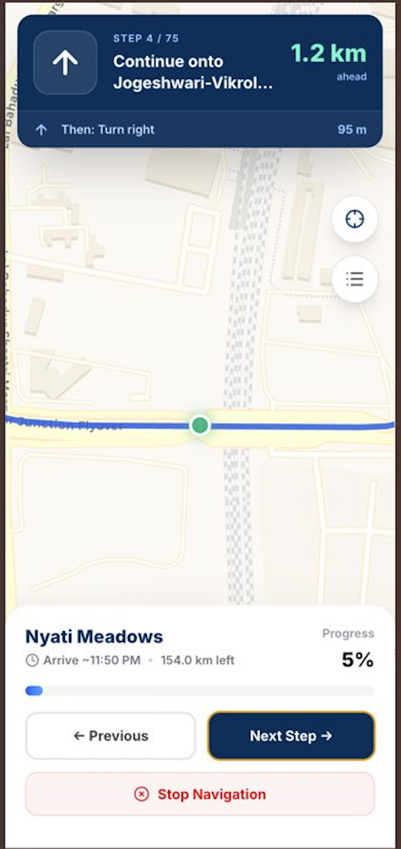
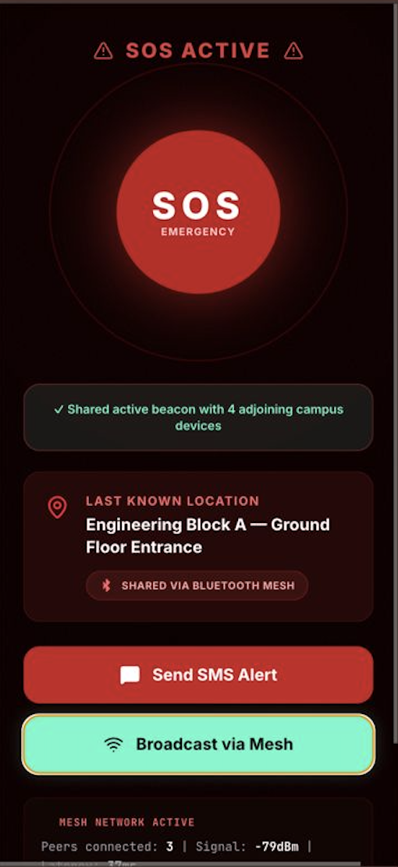
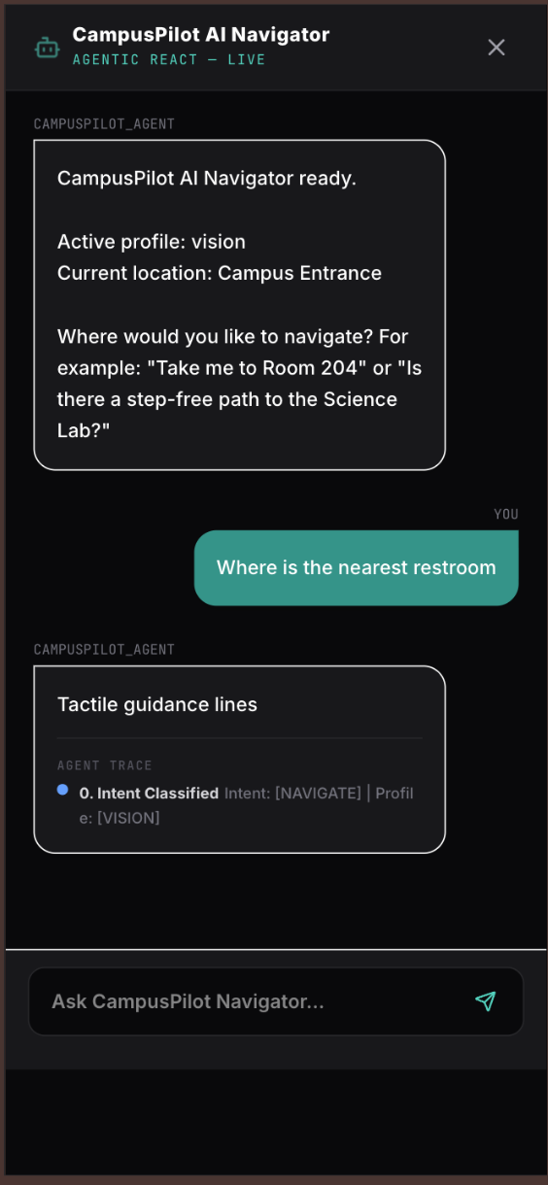
Solution Demonstration
Four real-world scenarios demonstrating AI-powered navigation, accessibility support, and emergency assistance
Indoor Navigation
Outdoor Route Guidance
Emergency Assistance
Accessibility-Aware Nav
QR-based indoor positioning with floor-aware routing and step-by-step navigation guidance.
Seamless navigation beyond campus buildings with real-time route progression and turn-by-turn directions.
Emergency mode instantly shares the user's last known location and enables SOS communication through SMS and mesh broadcasting.
Navigation adapts to the user's accessibility profile, providing tactile-path guidance and profile-specific route instructions.

Slide 8
Technical Architecture & Code Flow
From PWA to graph database — how a user request becomes a step-by-step accessible route.
4-Layer Architecture
Request Flow (step by step)
Key Components
Intent Classifier
intent_classifier.py
Keyword-based pre-LLM routing
React PWA (Vite + TypeScript)
1
User scans QR → frontend calls GET /qr/lookup?code=102 → returns building/floor/node ID
HTTP
2
User sends message → frontend calls POST /navigate with {origin, destination, profile}
Agent Orchestrator
agent.py
ReAct loop, memory injection, route extraction
FastAPI Backend (Python)
3
FastAPI router creates CampusPilotAgent, enriches input with [Context: Intent=navigate, Profile=Wheelchair, Location=Main Entrance]
Tool: route_query
tools.py
Neo4j shortest accessible path
LangChain Agent
(Llama 3.3 70B via Groq)
4
classify_intent() runs first (heuristic, <1ms) — emergency → return immediately; else → pass to LLM
Tool: qr_lookup
tools.py
QR code → campus node
Neo4j Graph Database
5
LangChain AgentExecutor runs ReAct loop: Thought → tool call → Observation → repeat until complete
Memory
memory.py
Session state: location, profile, history
Performance
Graph pathfinding: <15ms
FastAPI overhead: <5ms
Total e2e (with LLM): ~200ms
6
route_query calls Neo4j Cypher with accessibility filters → returns node path + edge weights
Graph Schema
schema.cypher
6 node types, CONNECTS_TO with accessibility props
7
Agent formats step-by-step directions → FastAPI wraps as RouteOption response → frontend renders

Slide 9
Challenges & Learnings
Challenge
How We Addressed It
LLM hallucination risk
Agent could invent a room or route
All room IDs and paths come from Neo4j; LLM only formats response text. Room resolved via resolve_room() tool, never generated by the model
Emergency latency
Cannot wait 800ms for LLM detection
Heuristic classify_intent() fires before LLM is invoked. Emergency is pre-LLM, not post-LLM
Disability profiles affecting routing
Not just wording
Profiles operationalised as Cypher query constraint dicts in profile_handler.py — affect actual graph traversal, not just the system prompt
Indoor Positioning Accuracy
GPS is unreliable indoors
QR codes at corridor junctions, lift lobbies, and entrances. Position is point-based; we surface this honestly with "last known location"
Key Learnings
Agentic AI requires a safety layer because critical situations cannot always rely on LLM reasoning, especially when users may need immediate assistance. Graph databases proved highly effective for multi-constraint routing, making accessibility-aware navigation much easier to model and query. We also learned that WCAG compliance alone is not enough, as meaningful accessibility requires validation through assistive technologies and real user testing. Finally, in-memory session state was sufficient for a prototype, while the architecture remains flexible enough to support scalable solutions such as Redis in the future.

